Slide 1
Storage

Slide 2
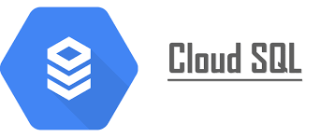
Cloud SQL

Slide 3
Agenda
What is Cloud SQL?
What Cloud SQL provides?
What is a Cloud SQL instance
Features of Cloud SQl
Cloud SQL High Availability
Cloud SQL for MySQL documentation
Connect to your instance
Create a database and upload data
Cloud SQL Proxy

Slide 4


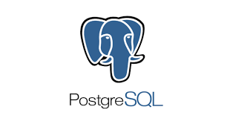
What is Cloud SQL?
It is a fully managed relational database for services like MySQL, PostgreSQL, and SQL servers. The GCP platform provides rich ecosystem, but without the hassle of self management.
Some of the use cases for cloud sql are:
Cloud SQL provides a cloud-based alternative databases. You should use Cloud SQL if you want to spend less time managing your database and more time using it.
Many applications running on Compute Engine, App Engine and other services in Google Cloud use Cloud SQL for database storage.
Notes:
https://www.google.com/url?sa=i&url=https%3A%2F%2Fhevodata.com%2Flearn%2Fgoogle-cloud-mysql%2F&psig=AOvVaw1b3B9RZi3Hm6Hl47w5sXwo&ust=1649602795050000&source=images&cd=vfe&ved=0CAoQjRxqFwoTCIjDv7ifh_cCFQAAAAAdAAAAABAD

Slide 5
What Cloud SQL provides?
The Cloud sql provides the following features:
Backuos
High availability and failover
Network connectivity
Export and import
Maintenance and updates
Monitoring
Logging

Slide 6
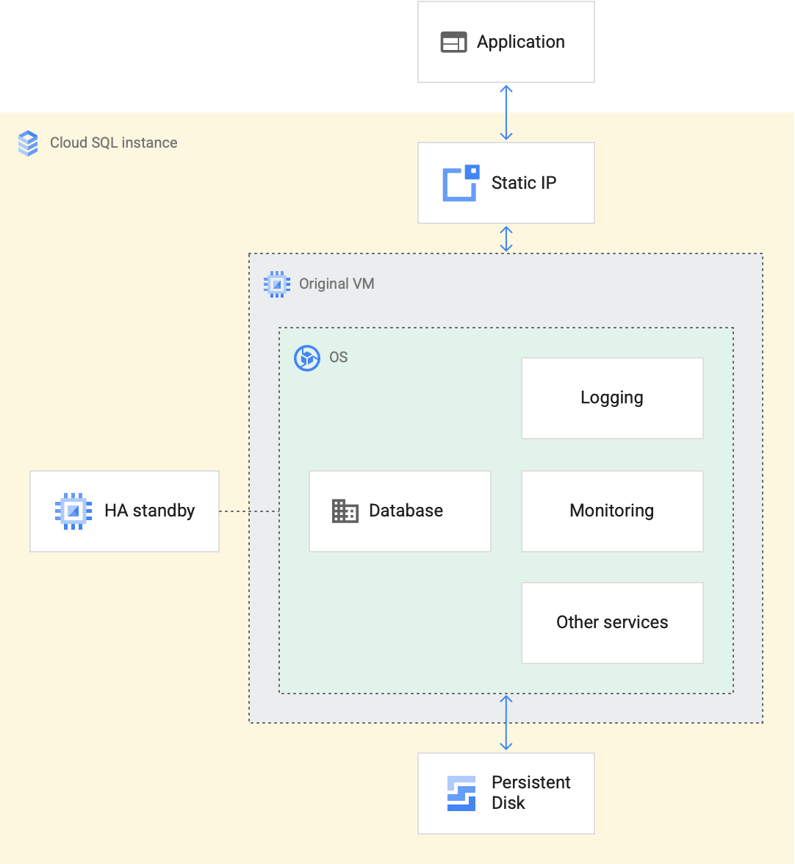
What is a Cloud SQL instance?
Each Cloud SQL instance is powered by a virtual machine (VM) running on a host Google Cloud server. Each VM operates the database program, such as MySQL Server, PostgreSQL, or SQL Server, and service agents that provide supporting services, such as logging and monitoring. The high availability option also provides a standby VM in another zone with a configuration that's identical to the primary VM.
The database is stored on a scalable, durable network storage device called a persistent disk that attaches to the VM. A static IP address sits in front of each VM to ensure that the IP address an application connects to persists throughout the lifetime of the Cloud SQL instance.
Credit: https://miro.medium.com/max/1400/1*7TAir3G4w1QxiWoVZrPEQQ.png
Notes:
https://cloud.google.com/sql/images/intro2.png

Slide 7
Features of Cloud SQL
Fast, easy migrations : Database Migration Service makes it easy to migrate databases from on-premises, Compute Engine, and other clouds to Cloud SQL with minimal downtime.
Secure access and connectivity : Cloud SQL data is encrypted when on Google’s internal networks and when stored in database tables, temporary files, and backups. Cloud SQL supports private connectivity with Virtual Private Cloud (VPC), and every Cloud SQL instance includes a network firewall, allowing you to control public network access to your database instance.
Built-in high availability: Replicate your instance to another zone or region with just a click of a button. Leverage built-in HA to provide isolation from many types of infrastructure hardware, and software failures.
Scalability: Easily scale up as your data grows—add up to 96 processor cores and more than 624 GB of RAM and 64 TB of storage and add read replicas to handle increasing read traffic.

Slide 8
Cloud SQL Insights: Quickly understand and resolve database performance issues on Cloud SQL. Pre-built dashboards and visual query plans help developers identify the root cause of problems. Access database metrics and traces in existing tools using Open Telemetry. Monitor databases through the lens of the application using query tags. Available now for PostgreSQL, with MySQL in preview.
Automatic storage increases: Cloud SQL can automatically scale up storage capacity when you are near your limit. This way you don’t have to spend time estimating future storage needs or spend money on capacity until you need it.
High performance: Cloud SQL supports performance-intensive workloads with up to 60,000 IOPS and no extra cost for IO.
Easy integration: Access Cloud SQL instances from just about any application. Easily connect from App Engine, Compute Engine, Google Kubernetes Engine, and your workstation. Open up analytics possibilities by using Big Query to directly query your Cloud SQL databases.
Real-time change data capture and replication: Synchronize data across heterogeneous databases, storage systems, and applications reliably and with minimal latency with Data stream. Seamlessly deliver change streams from Oracle and MySQL databases into Google Cloud services such as BigQuery, Cloud SQL, Google Cloud Storage, and Cloud Spanner for up-to-date information.

Slide 9
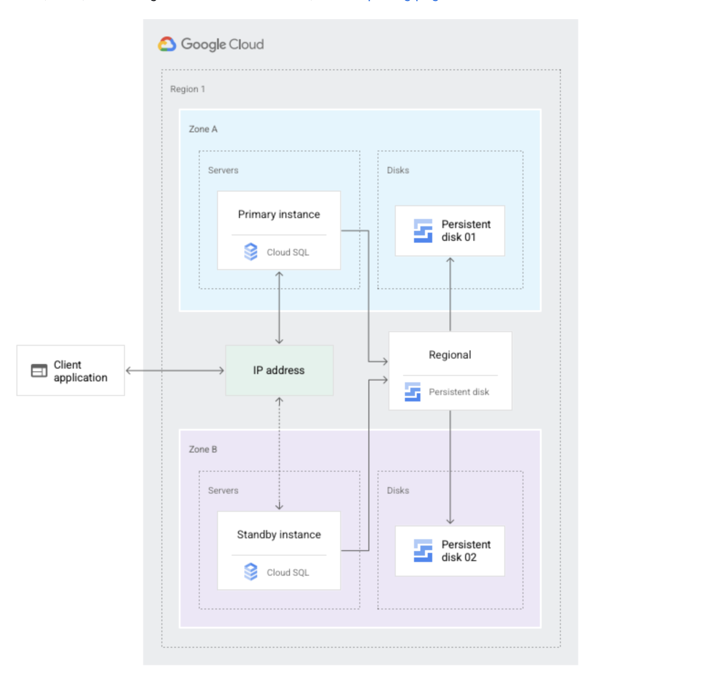
Cloud SQL High Availability
Cloud SQL instance HA configuration provides data redundancy and failover capability with minimal downtime, when a zone or instance becomes unavailable due to a zonal outage, or an instance corruption
HA configuration is also called a regional instance or cluster
With HA, the data continues to be available to client applications.
HA is made up of a primary and a standby instance and is located in a primary and secondary zone within the configured region
If an HA-configured instance becomes unresponsive, Cloud SQL automatically switches to serving data from the standby instance.
Data is synchronously replicated to each zone’s persistent disk, all writes made to the primary instance are replicated to disks in both zones before a transaction is reported as committed.
In the event of an instance or zone failure, the persistent disk is attached to the standby instance, and it becomes the new primary instance.
After a failover, the instance that received the failover continues to be the primary instance, even after the original instance comes back online.
Once the zone or instance that experienced an outage becomes available again, the original primary instance is destroyed and recreated, and It becomes the new standby instance.
If a failover occurs in the future, the new primary will failover to the original instance in the original zone.
Credit: https://cloud.google.com/sql/images/ha-config-replica.svg
Notes:
https://jayendrapatil.com/wp-content/uploads/2021/03/Cloud-SQL-High-Availability.png

Slide 10
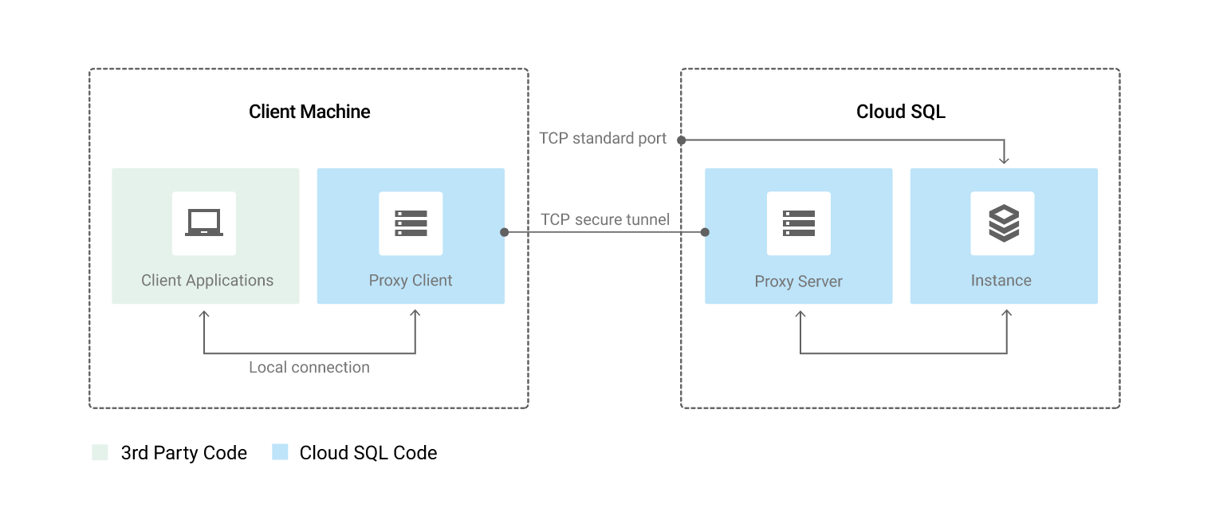
Cloud SQL Proxy
Cloud SQL Proxy provides secure access to the instances without the need for Authorized networks or for configuring SSL.
Secure connections : Cloud SQL Proxy automatically encrypts traffic to and from the database using TLS 1.2 with a 128-bit AES cipher; SSL certificates are used to verify client and server identities.
Easier connection management : Cloud SQL Proxy handles authentication removing the need to provide static IP addresses.
Cloud SQL Proxy does not provide a new connectivity path; it relies on existing IP connectivity. To connect to a Cloud SQL instance using private IP, the Cloud SQL Proxy must be on a resource with access to the same VPC network as the instance.
Cloud SQL Proxy works by having a local client running in the local environment. The application communicates with the Cloud SQL Proxy with the standard database protocol used by the database.
Cloud SQL Proxy uses a secure tunnel to communicate with its companion process running on the server.
While the proxy can listen on any port, it only creates outgoing connections to the Cloud SQL instance on port 3307.
Credit: https://cloud.google.com/sql/images/proxyconnection.svg

Slide 11
Cloud SQL for MySQL documentation
Connect to Cloud SQL for MySQL from Cloud Shell:
In the Google Cloud Console, on the project selector page, select or create a Google Cloud project.
Make sure that billing is enabled for your Cloud project. Learn how to check if billing is enabled on a project.
Enable the necessary Google Cloud APIs
Create a Cloud SQL instance
In the Google Cloud Console, go to the Cloud SQL Instances page.
Click Create Instance
Click Choose MySQL
Enter myinstance for Instance ID
Enter the password for root user.
Click create

Slide 12
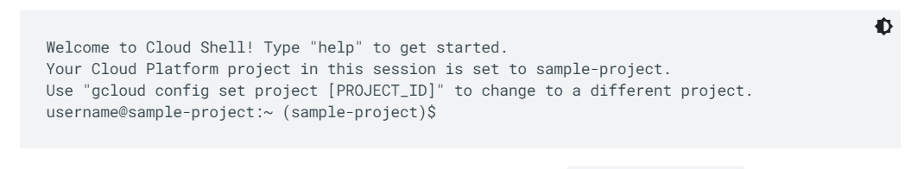

Connect to your instance
In the Google Cloud Console, click the Cloud Shell icon in the upper right corner.
When Cloud Shell finishes initializing, a message, such as the following one, appears: following one, appears:
At the Cloud Shell prompt, connect to your Cloud SQL instance. Use the gcloud sql connect command as follows. Replace the instance name if your instance name is different.
Notes:
https://cloud.google.com/sql/docs/mysql/connect-instance-cloud-shell

Slide 13

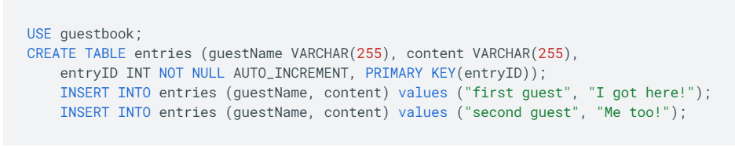
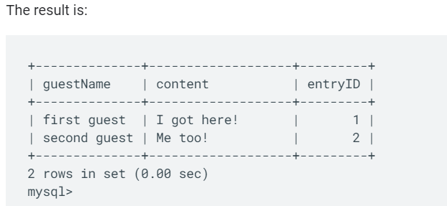

Create a database and upload data
Create a SQL database on your Cloud SQL instance
Insert sample data into the guestbook database:
Credit: https://cloud.google.com/sql/docs/mysql/connect-instance-cloud-shell
Retrieve the data:
Notes:
https://cloud.google.com/sql/docs/mysql/connect-instance-cloud-shell

Slide 14
Clean up options
Click Authorize in the message box to authorize Cloud Shell to make API calls.
A message indicates that your IP is being allow listed for incoming connections, after which you're prompted to enter your password.
Enter your root password.
The mysql prompt appears.
To avoid incurring charges to your Google Cloud account for the resources used on this page, follow these steps.
In the Google Cloud Console, go to the Cloud SQL Instances page.
Select the myinstance instance to open the Instance details page.
In the icon bar at the top of the page, click Delete.
In the Delete instance window, type your instance's name and then click Delete.
You cannot reuse an instance name for about 7 days after the instance is deleted.

Slide 15

GOOGLE CLOUD DATASTORE

Slide 16

What is Google Cloud Datastore
On the Google Cloud Platform, Google Cloud Datastore (Cloud Datastore) is a highly scalable, fully managed NoSQL database service. Cloud storage "allows you to save data and files in an off-site location that you can access either over the public internet or a dedicated private network connection. Because actual files may be replaced with cloud storage records, this is a particularly cost-effective solution for enterprises.
Google's Bigtable and Megastore technology are at the heart of Cloud Datastore. Users can construct databases in either Native or Datastore Mode with Google Cloud Datastore. Datastore Mode is suited for new server projects, whereas Native Mode is designed for mobile and web apps
Reference for contents : https://cloud.google.com/bigtable/docs/overview
Notes:
Reference for contents : https://cloud.google.com/bigtable/docs/overview

Slide 17
Overview
Datastore is a NoSQL document database designed for easy application development, automatic scaling, and great performance. The following are some of the datastore's features:
Atomic transactions. Datastore can perform a set of operations in which all of them succeed or none of them fail.
High availability of reads and writes. Datastore is hosted by Google, which uses redundancy to reduce the impact of single points of failure.
Massive scalability with high performance. To manage scaling, Datastore employs a distributed design. Datastore employs a combination of indexes and query constraints to ensure that your queries scale in accordance with the size of your result set rather than the size of your data set.
Flexible storage and querying of data. Datastore is offered to applications through numerous clients and maps naturally to object-oriented and scripting languages. It also has a query language that is similar to SQL.

Slide 18
Overview
Balance of strong and eventual consistency. Datastore makes guarantee that entity lookups based on key and ancestor searches always return highly consistent results. All other queries finally come to a conclusion. The consistency models enable your programme to provide a pleasant user experience even when it's dealing with a lot of data and users.
Encryption at rest. All data in Datastore is automatically encrypted before being written to disc, and it is also immediately decrypted when accessed by an authorised user.
Fully managed with no planned downtime. You may concentrate on your applications while Google maintains the Datastore service. When Datastore undergoes a planned upgrade, your application can continue to use it.

Slide 19

It’s Simple and Integrated
Datastore's RESTful interface allows any deployment target to readily access data. You can use Datastore as the integration point for solutions that span App Engine and Compute Engine.
Notes:
Reference for contents : https://cloud.google.com/bigtable/docs/overview

Slide 20

Easy to use Query Language
Datastore is a schema-less database, which means you don't have to worry about changing your underlying data structure as your app grows. Datastore comes with a robust query engine that lets you search for data across many characteristics and organise it accordingly.
1. // List Google companies with fewer than 400 employees.
2. var companies = query.filter('name =', 'Google').filter('size <', 400);
Notes:
Reference for contents : https://cloud.google.com/bigtable/docs/overview

Slide 21
Features
Rich Admin Dashboard
View entity stats, query your database, look at indexes, and backup and restore your data.
Diverse Data Types
Integers, floating-point numbers, texts, dates, and binary data are among data types supported by Datastore.
Multiple Access Methods
You can use a JSON API, open source clients, or community-maintained ORMs to access your data.
ACID Transactions
Ensure integrity of data by combining numerous datastore activities into a single transaction with ACID properties, ensuring that all of the aggregated operations succeed or fail.
Fully managed
Since Datastore is fully managed, Google takes care of workloads and replication for you, ensuring a highly available and consistent database.
Notes:
Reference for contents :

Slide 22
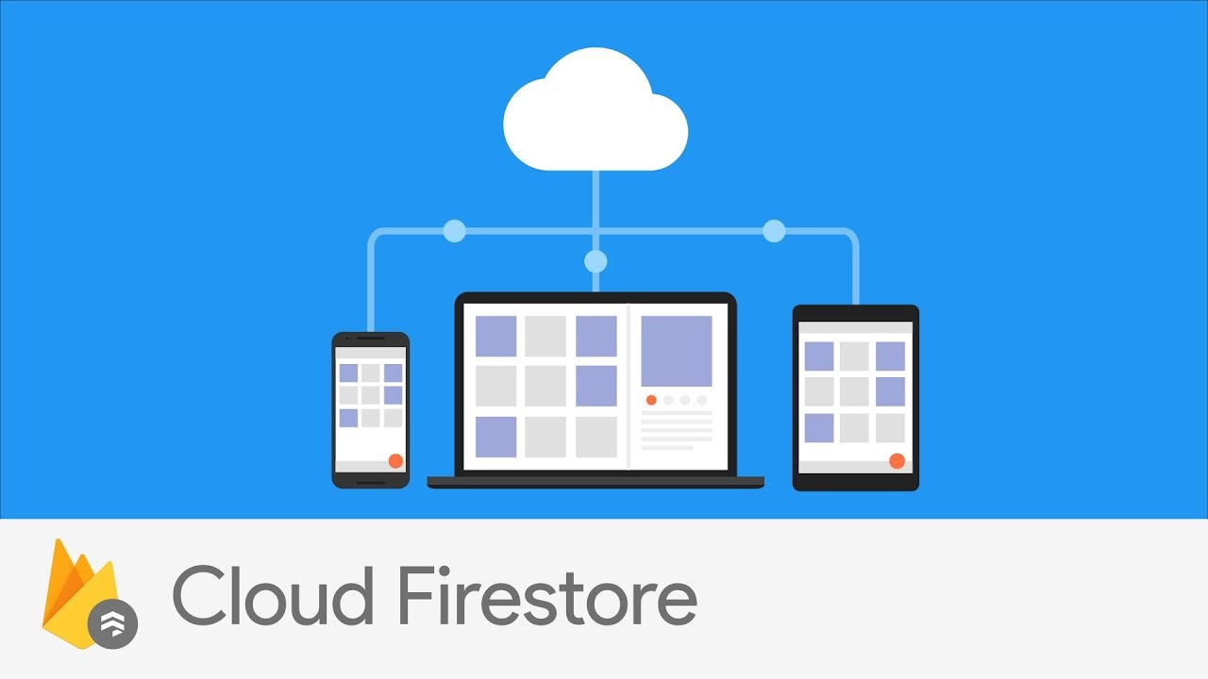
Firestore in Datastore Mode
Firestore is the most recent version of Datastore, and it includes significant enhancements over the previous version. Existing Datastore customers can take advantage of these enhancements by creating a new Firestore database instance in Datastore mode. All existing Datastore databases will be upgraded to Firestore in Datastore mode in the future.
Notes:
Reference for contents : https://docs.aws.amazon.com/AWSEC2/latest/UserGuide/concepts.html
More explanation: jdhcdca;sdhasdhad

Slide 23
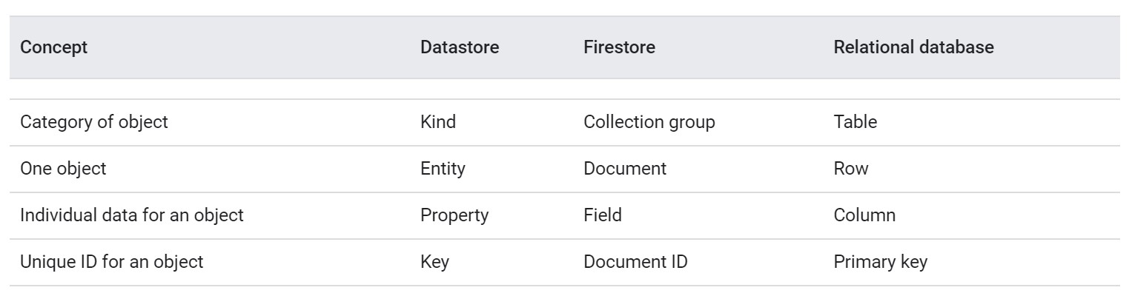
Comparison with traditional databases
While the Datastore interface shares many of the same capabilities as traditional databases, it differs in how it describes relationships between data items as a NoSQL database. Here's how Datastore and relational database ideas compare at a high level:
Datastore entities of the same type, unlike rows in a relational database table, can have distinct attributes, and different entities can have properties with the same name but different value types. These distinct traits necessitate a new approach to data design and management in order to take advantage of the potential to scale automatically.
Notes:
Reference for contents : https://docs.aws.amazon.com/AWSEC2/latest/UserGuide/concepts.html
More explanation: jdhcdca;sdhasdhad

Slide 24
In particular, Datastore differs from a traditional relational database in the following important ways:
Datastore is built to grow to very big data sets automatically, allowing applications to maintain good performance as traffic increases:
Datastore writes scale by spreading data automatically as needed.
Because the only queries supported are those whose speed scales with the size of the result set, datastore reads scale (as opposed to the data set). This means that a query with a result set of 100 entities will return the same results whether it looks for a hundred or a million. This attribute is the main reason why some query types aren't supported.
Because all queries are provided by indexes that have already been established, the types of queries that can be run are more limited than those that can be run on a relational database using SQL.
Datastore is associated with flow, unlike typical relational databases, which enforce a schema. It is not necessary for entities of the same type to have the same set of characteristics (although you can choose to enforce such a requirement in your own application code).
Notes:
Reference for contents : https://docs.aws.amazon.com/AWSEC2/latest/UserGuide/concepts.html
More explanation: jdhcdca;sdhasdhad

Slide 25
What it's good for
Datastore is excellent for large-scale applications that require highly accessible structured data. All of the following forms of data can be stored and queried using Datastore:
Product catalogues that provide a retailer with real-time inventory and product details.
User profiles that provide a personalised experience based on a user's previous activities and preferences.
ACID-based transactions, such as transferring funds from one bank account to another.
Notes:
Reference for contents : https://docs.aws.amazon.com/AWSEC2/latest/UserGuide/concepts.html
More explanation: jdhcdca;sdhasdhad

Slide 26
Other storage and database options
Datastore is not suitable for all applications. Datastore, for example, is not a relational database and is not an effective solution for analytic data.
Here are some common situations in that you should likely find Datastore as an alternative:
Consider Cloud SQL if you require a relational database with full SQL support for an online transaction processing (OLTP) system.
Consider Cloud Bigtable if you don't need ACID transaction support or if your data isn't highly structured.
Consider Big Query if you require interactive querying in an online analytical processing (OLAP) system.
Consider Cloud Storage if you need to store large immutable blobs, such as large images or movies.
Notes:
Reference for contents : https://docs.aws.amazon.com/AWSEC2/latest/UserGuide/concepts.html
More explanation: jdhcdca;sdhasdhad

Slide 27
Cloud Datastore Best Practices
The best practises listed here can be used as a quick reference for what to keep in mind when developing an application that uses Datastore.
1) GENERAL
For namespace names, kind names, property names, and custom key names, always use UTF-8 characters. Non-UTF-8 characters in these names may cause Datastore functionality to fail. A non-UTF-8 character in a property name, for example, can prevent the creation of an indicator that uses the property.
In kind or custom key names, do not use a forward slash (/). Forward slashes in these names may cause problems in the future.
Store sensitive information in a Cloud Project ID at your own risk. A Cloud Project ID may be kept after the completion of your project
Notes:
Reference for contents : https://docs.aws.amazon.com/AWSEC2/latest/UserGuide/concepts.html
More explanation: jdhcdca;sdhasdhad

Slide 28

Cloud Datastore Best Practices
2) API CALLS
Instead of single operations, use batch operations for reads, writes, and deletes. Because batch operations conduct number of operations with the same administrative costs as a single operation, they are more efficient.
If a transaction fails, make an attempt to roll it back. The rollback reduces retry latency for a different request in a transaction that is trying to compete for the same resource(s). Because a rollback may fail, the rollback will only be a best-effort attempt.
When possible, use asynchronous calls instead of synchronous calls. Asynchronous calls reduce the impact of latency. Consider an application that requires the results of a synchronous lookup() and a query before it can render a response. If the lookup() and the query do not share any data, there is no need to synchronously wait for the lookup() to finish before starting the query.
Notes:
Reference for contents : https://docs.aws.amazon.com/AWSEC2/latest/UserGuide/concepts.html
More explanation: jdhcdca;sdhasdhad

Slide 29
Cloud Datastore Best Practices
3) ENTITIES
Entity groups are used to group data that is highly related. Ancestor queries are made possible by entity groups, and the results are highly consistent. Because the entities in an entity group are stored in physically close places on Datastore servers, ancestor queries can quickly scan an entity group with minimal I/O.
Write to an entity group no more than once per second. Writing at a sustained rate above that limit makes eventually consistent reads more likely, causes time outs for strongly consistent reads, and slows down your application's overall performance. A batch or transactional write to an entity group counts as only one write toward this limit.
Include the same entity (by key) no more than once in the same commit. The inclusion of the same entity multiple times in the same commit may have an impact on Datastore latency.
Notes:
Reference for contents : https://docs.aws.amazon.com/AWSEC2/latest/UserGuide/concepts.html
More explanation: jdhcdca;sdhasdhad

Slide 30
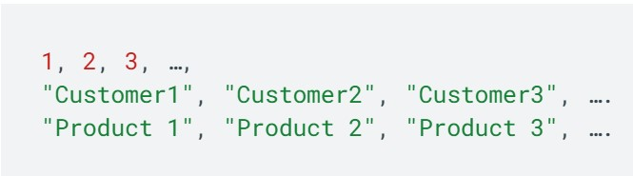
Cloud Datastore Best Practices
4) KEYS
Except for a forward slash (/), always use UTF-8 characters for a key with a custom name. Non-UTF-8 characters wreak havoc on a variety of processes, including importing a Datastore backup into Google BigQuery. A forward slash could obstruct future functionality.
If you want to give your entities a manual numeric ID or a custom name, don't use monotonically increasing values like:
If an application generates a large amount of traffic, such sequential numbering may result in hotspots that affect Datastore latency. To avoid the problem of sequential numeric IDs, use the allocateIds() method to obtain numeric IDs. The allocated method generates evenly spaced sequences of numeric IDs.
Notes:
Reference for contents : https://docs.aws.amazon.com/AWSEC2/latest/UserGuide/concepts.html
More explanation: jdhcdca;sdhasdhad

Slide 31
Cloud Datastore Best Practices
5) INDEXES
Exclude a property from indexes if it will never be used in a query. Unnecessary indexing of a property may result in increased latency to achieve consistency and increased index entry storage costs.
Avoid using an excessive number of composite indices. Excessive use of composite indexes may result in increased latency to achieve consistency and increased index entry storage costs. Use Google BigQuery if you need to run ad hoc queries on large datasets with no previously defined indexes.
6) PROPERTIES
For string properties, always use UTF-8 characters. A non-UTF-8 character in a string property could cause queries to fail. Use a byte string to save data that contains non-UTF-8 characters.
Dots should not be used in property names. Dots in property names cause indexing of embedded entity properties to fail.
Notes:
Reference for contents : https://docs.aws.amazon.com/AWSEC2/latest/UserGuide/concepts.html
More explanation: jdhcdca;sdhasdhad

Slide 32
Cloud Datastore Best Practices
7) QUERIES
Use a keys-only query if you only need to access the key from the query results. A keys-only query yields results faster and at a lower cost than retrieving entire entities.
Use a projection query if you only need to access specific properties from an entity. When compared to retrieving entire entities, a projection query returns results with less latency and cost.
Similarly, if you need to access only the properties that are included in the query filter (for example, those listed in an order by clause), use a projection query.Do not use offsets. Instead, use cursors. Using an offset only prevents your application from returning skipped entities, but these entities are still retrieved internally. The skipped entities affect query latency, and your application is charged for the read operations required to retrieve them.
Use an ancestor query if you need strong consistency in your queries. (Before you can use ancestor queries, you must first structure your data to ensure strong consistency.) An ancestor query yields results that are highly consistent. Note that a non-ancestor keys-only query followed by a lookup() does not return strong results, because the non-ancestor keys-only query could get results from an index that is not consistent at the time of the query.
Notes:
Reference for contents : https://docs.aws.amazon.com/AWSEC2/latest/UserGuide/concepts.html
More explanation: jdhcdca;sdhasdhad

Slide 33
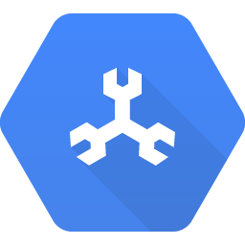
GOOGLE CLOUD SPANNER

Slide 34
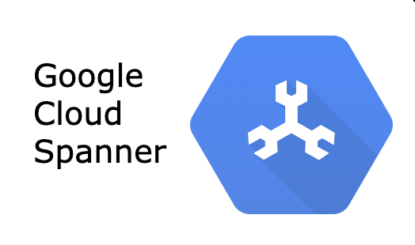
What is Google Cloud Spanner
Cloud Spanner is the only enterprise-grade, globally distributed, and strongly consistent database service designed specifically for the cloud, combining the benefits of relational database structure with non-relational horizontal scale. It is a one-of-a-kind database that combines transactions, SQL queries, and relational structure with the scalability associated with non-relational or NoSQL databases.
Notes:
Reference for contents : https://cloud.google.com/bigtable/docs/overview

Slide 35
How does it work?
The following image depicts a four-node regional Cloud Spanner instance hosting two databases. In Spanner, a node is a unit of computation. Node servers process read and write/commit transaction requests but do not store data. Each node in the region is replicated across three zones. The storage of the database is also replicated across the three zones. Nodes in a zone are responsible for reading and writing to their zone's storage. The data is stored in Google's underlying distributed replicated file system, Colossus. This provides huge advantages when it comes to redistributing load, as the data is not linked to individual nodes. If a node or a zone fails, the database remains available, being served by the remaining nodes. No manual intervention is needed to maintain availability.
Because the data is not linked to individual nodes, this provides significant benefits when it comes to redistributing load. If a node or a zone fails, the database is still accessible and is served by the remaining nodes. To keep availability, no manual intervention is required.

Slide 36
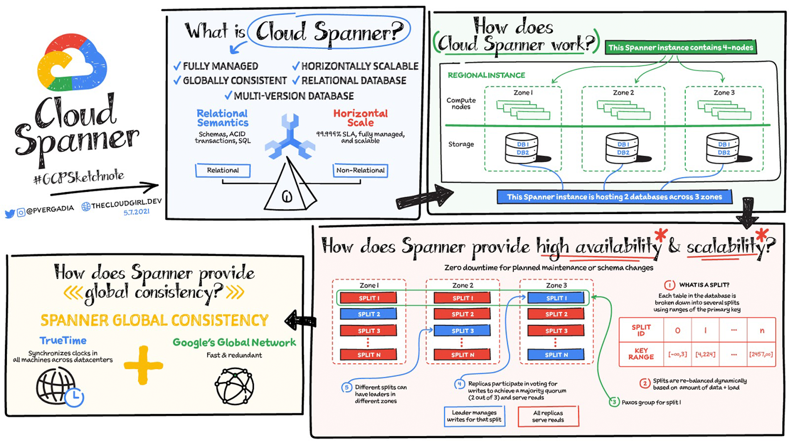
Google Cloud Spanner
Notes:
Reference for contents : https://cloud.google.com/bigtable/docs/overview#what-its-good-for

Slide 37
How does Spanner provide high availability and scalability?
The primary key is used to sort each table in the database. Tables are divided by ranges of the primary key, which are referred to as splits. Different Spanner nodes manage each split completely independently. The number of splits in a table depends on the amount of data: empty tables have only one split. The splits are dynamically rebalanced based on the amount of data and the load (dynamic resharding). However, keep in mind that the table and nodes are replicated across three zones; how does this work?
Everything is replicated across the three zones, including split management. Split replicas are linked to a zone-spanning group (Paxos). One of the zones is chosen as the leader using Paxos consensus protocols. The leader is in charge of handling write transactions for that split, while the other replicas can handle reads. If a leader fails, the consensus is reset, and a new leader is chosen. Different zones can become leaders for different splits, distributing leadership roles among all Cloud Spanner compute nodes. Nodes will most likely serve as both leaders and replicas for some splits. Cloud Spanner achieves high availability and scalability by utilising this distributed mechanism of splits, leaders, and replicas.
Notes:
Reference for contents : https://cloud.google.com/bigtable/docs/overview

Slide 38
How do reads and writes work?
There are two types of reads in Cloud Spanner:
Strong reads - used when the absolute most recent value must be read. The following is how it works:
The Cloud Spanner API locates the split, looks up the Paxo's group to be used for the split, and routes the request to one of the replicas (usually in the same zone as the client) In this case, the request is routed to zone 1's read-only replica.
The replica asks the leader if it is safe to read and for the True Time timestamp of the most recent transaction on this row.
The replica compares the response to its own state as the leader responds.
It can return the result if the row is up to date. Otherwise, it must wait for updates from the leader.
The client receives the response.
Notes:
Reference for contents :

Slide 39
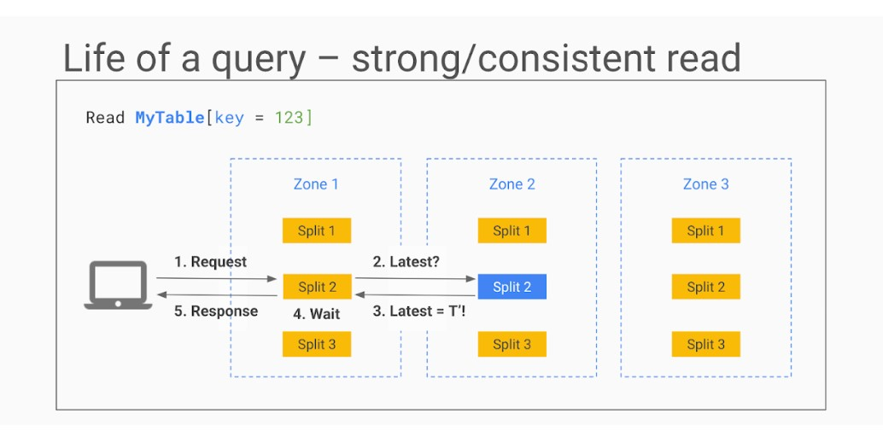
How do reads and writes work?
In some cases, such as when the row has recently been updated while the read request is in transit, the replica's state is sufficiently up to date that it does not even need to ask the leader for the most recent transaction.
Notes:
Reference for contents : https://docs.aws.amazon.com/AWSEC2/latest/UserGuide/concepts.html
More explanation: jdhcdca;sdhasdhad

Slide 40
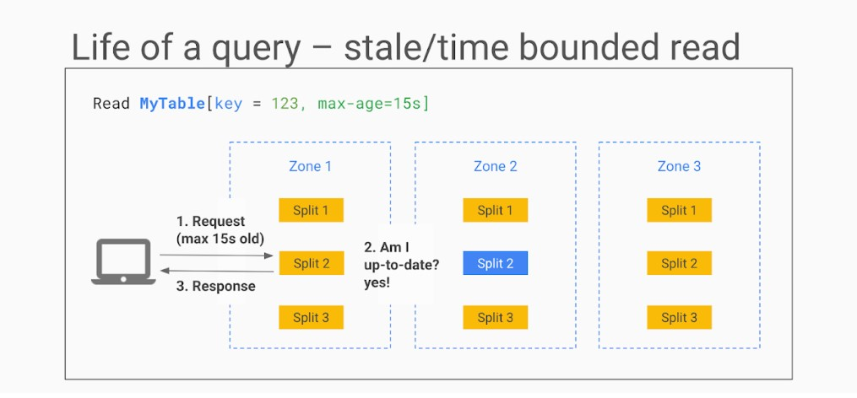
How do reads and writes work?
When low read latency is more important than getting the most recent values, stale reads are used, and some data staleness is tolerated. In a stale read, the client does not request the absolute most recent version, but rather the most recent data (e.g. up to n seconds old). If the staleness factor is at least 15 seconds, the replica can usually return the data without even querying the leader because its internal state indicates that the data is sufficiently up-to-date. As you can see, no row locking was required in any of these read requests - the ability for any node to respond to reads is what makes Cloud Spanner so fast and scalable.
Notes:
Reference for contents : https://docs.aws.amazon.com/AWSEC2/latest/UserGuide/concepts.html
More explanation: jdhcdca;sdhasdhad

Slide 41
How does Spanner provide global consistency?
TrueTime is required for Spanner to function properly...what is it, and how does it help?
TrueTime is a method of synchronising clocks across multiple datacenters. The system employs a hybrid of GPS and atomic clocks, with each compensating for the failure modes of the other. When the two sources are combined (with multiple redundancy, of course), an accurate time source for all Google applications is obtained. However, clock drift can still occur on each individual machine, and even with a sync every 30 seconds, the difference between the server's clock and the reference clock can be as much as 2ms. The drift will resemble a sawtooth graph with increasing uncertainty until corrected by a clock sync. TrueTime incorporates this uncertainty as part of the time signal because 2ms is quite a long duration (at least in computing terms).
Notes:
Reference for contents : https://docs.aws.amazon.com/AWSEC2/latest/UserGuide/concepts.html
More explanation: jdhcdca;sdhasdhad

